Slide 1
Kabaddi Hackthon - Submission
Ashok Gorantala
Devender Gakkula
Dated: 30th Sep 2019

Slide 2
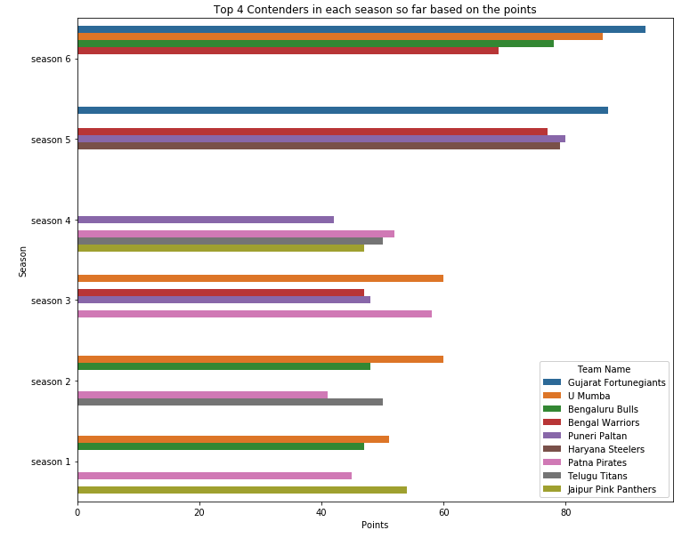
Task 1: Predict the winner of the tournament.
To predict the winner in Season-7, considering to see any consistent winners from Season 1 to Season 6
Looking at above results:
1. Above statistics are not showing consistent patterns; where any one of the team maintaining victory position.
2. Looking at Season 6 - Chances are Gujarat Fortunegiants or Bengal Warriors, Puneri Paltan or Bengaal Warriors are having high chances of winning Season - 7 Too.

Slide 3
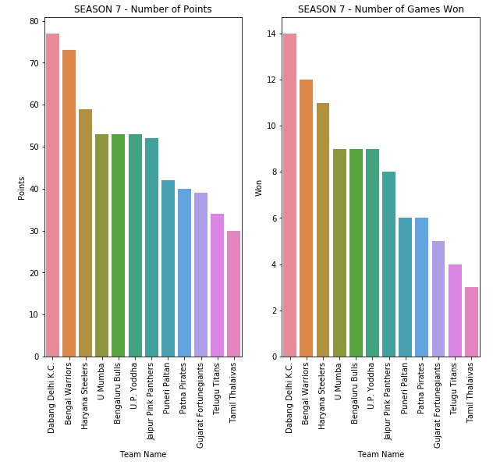
Task 1: Predict the winner of the tournament.
Season-7 Points and Win Analysis, so far..
Looking at above results:
1. Dabang Delhi K,C ,Bengal Warriors, Haryana Steelers or U-mumba are top 4 contenderes for Season 7 champion.
2. Out of all, Dabang Delhi KC and Bengal Warriors are going head-to-head.
3. Chances are one of the above teams will get the Season 7 Championship.
WITH NO CONCRETE RESULT PREDICTION ON TOP TEAM, MOVING AHEAD WITH COMPARING DIFFERENT PARAMETERS TO SEE THE WINNER OF THE GAME

Slide 4
Task 2: Predict the top team in the points table after the completion of the league matches.
Season-7 Points and Win Analysis, so far..

Slide 5
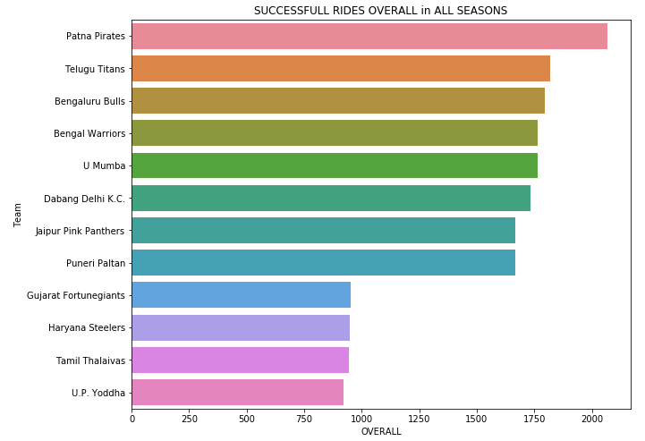
Task 3: Predict the team with the highest points for successful raids.
Successful rides in all season

Slide 6
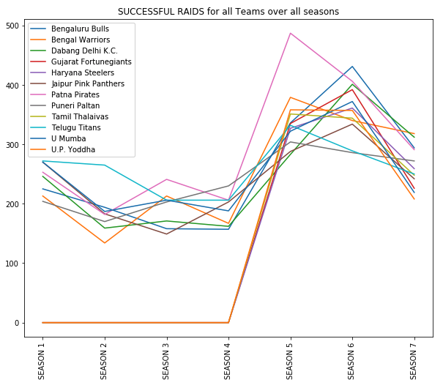
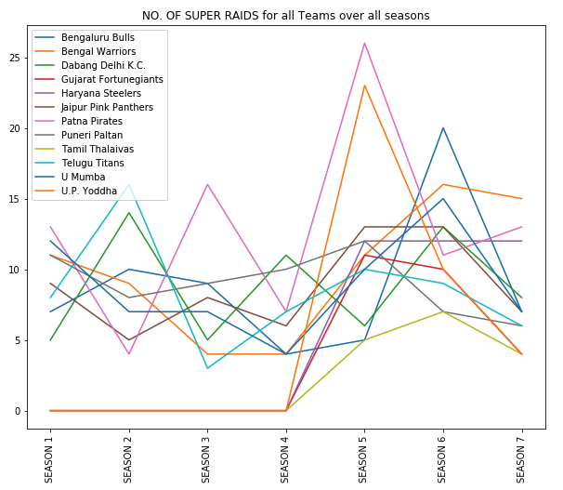
Task 3: Predict the team with the highest points for successful raids.
SUCCESSFUL RAIDS in all season
No, Of Super rides in all season

Slide 7
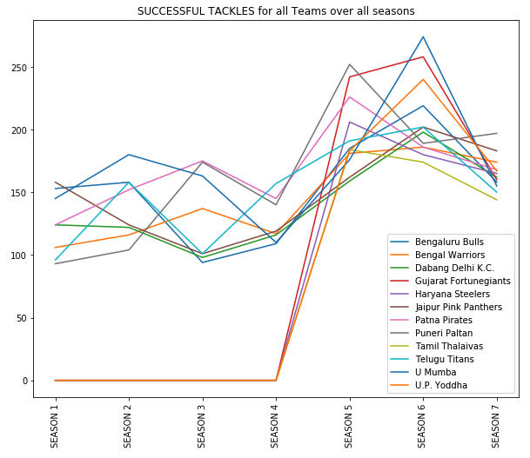
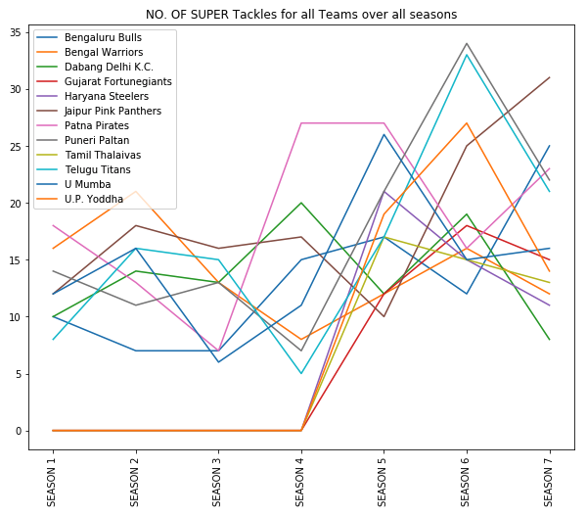
Task 4: Predict the team with the highest points for successful tackles
SUCCESSFUL Tackles in all season
No,. Super Tackles in all season

Slide 8
Considering, Top 4 contenders will have Successful Rides and Successful Tackles, plotting against Top-4 teams in Season-7
Looking at the Plots:
1. Dabang Delhi KC, consistently showing improvement in number of Wins
2. Similarly, Bengal Warriors too, maintaining a good number of wins in Season 7, and followed by Haryana Steelers and then U Mumba
3. Whereas in category of Successful Raids, Bengal Warriors is leading in Season 7, followed in very slight margin by Dabang Delhi KC and then Haryana Steelers and then U Mumba
4. U Mumba considered to be the best the Tacklers in Season 6; but in season 7, they plummeted down to lowest compared in between Top 4 contenders
5. All team are maintaining a slight margins of difference in area of Successful Tackles; starting with Bengal Warriors in first place, then Harayana Steelers, Dabanga Delhi KC and last is U Mumba
Winners:
Successful Raids - ???
Successful Tackles - ???

Slide 9
Considering, Top 4 contenders will have Successful Rides and Successful Tackles, plotting against Top-4 teams in Season-7
Looking at the Plots:
1. Dabang Delhi having less number of Super Successful Raids numerically, but, they have maximum number of Successful Ride %; that means they are getting most of rides as successful ones.
2. Whereas Bengal Warriors maintaing steady Successful Ride % and No Sucessful Rides too.
3. Whereas Haryana Steelers, recently joined the championship and proving to be strong contender in-terms of Success raides
4. U Mumba seems to be very strong contender in Tackle percentage and Successful Tackle Percentage too.
Winners:
Successful Raids - Dabang Delhi K,C
Successful Tackles - U Mumba

Slide 10
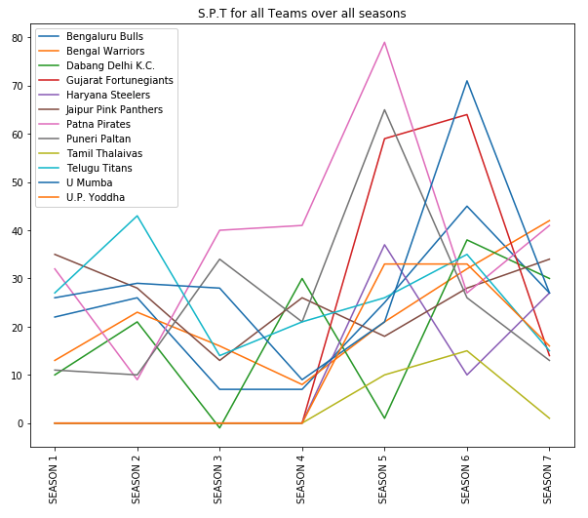
Task 5: Predict the team with the highest super-performance total.

Slide 11
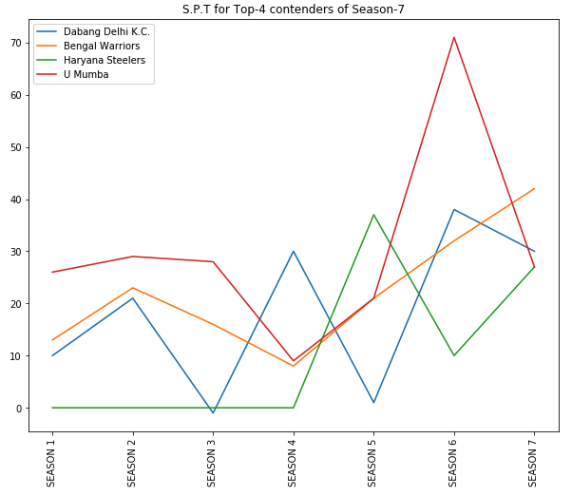
Task 5: Predict the team with the highest super-performance total.
WINNER:
SPT - Bengal Warriors
Looking at the Plots:
1. Considering Bengal Warriors toping the points table in Season-7, chances are Bengal Warriors will lead the SPT area.

Slide 12
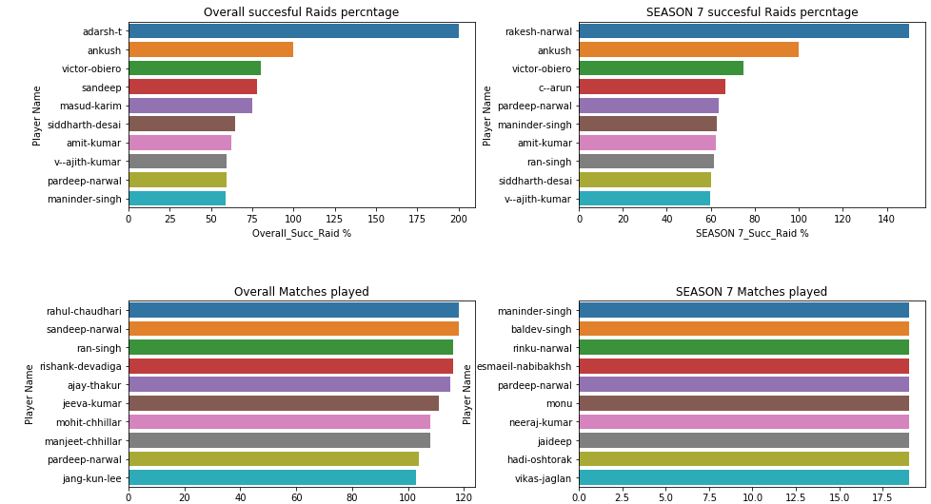
Task 6: Predict the player with the highest SUCCESSFUL RAID percentage
From the above graph we can analyze the below insights:
Overall Successful raid % for player without considering Overall Matches played ‘Adarsh’ is highest.
Overall Successful raid % for player with Overall Matches played and Overall Successful raid % 'Pradeep Narwal' scores highest.
Season-7 Successful raid % for player 'Rakesh narawal' is highest.
Season-7 Successful raid % for player considering season-7 most no matches played is Pradeep narwaal
To conclude, if Pradeep narwal is in the final team, he may emerge as player with highest successful raid %

Slide 13
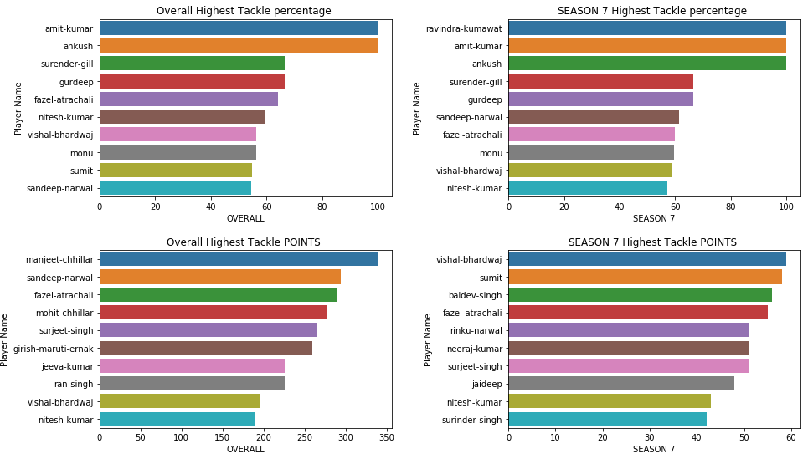
Task 7: Predict the player with the highest SUCCESSFUL TACKLE percentage
From the above plots we can analyze the below insights:
1.Overall Successful tackle % is highest for 'Amit-Kumar' and 'Anushk‘ ; Match points are low; NOT top contenders. 2.Overall Highest tackle POINTS is highest for 'Manjeet Chillar' and 'Sandeep-Narwal'. Season 7 match points are low, NOT top contenders in Season 7. 3.Season-7 tackle PTS :high for 'Vishal Bhardwaj' and 'Sumit'.Overall match pts are low, NOT top contenders for season 7.
To conclude, if 'Vishal Bhardwaj' and 'Fazel atrachali' seems top two contenders with overall and Season 7 tackle points, and percentage. Between these two ‘VISHAL BHARADWAJ' CAN BE predicted as having highest tackle percentage

